Slide 1
Exchange and integration of road assets
A Semantic Web Solution to Interoperability in the V-Con Project
Sander Stolk
& Nic Roest

Slide 2
Outline
Who are we?
V-Con project
Our design
Demonstration
Questions
V-con, The solution for data sharing
© Copyright Arcadis-Semmtech 2016
Notes:
Dick Grotholt PM Arcadis
Nic Roest director semantic consultancy

Slide 3
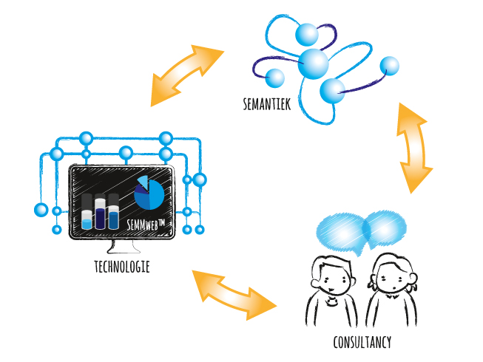
Introducing Semmtech
© Copyright Arcadis-Semmtech 2016
Notes:
Semmtech is the main subcontractor of Arcadis in V-Con
Semmtech is an innovative, medium-sized ICT and consultancy firm
Focus is on developing, implementing ICT technology that is based on semantic modeling techniques

Slide 4
Introducing Semmtech
Excel in Information modelling
© Copyright Arcadis-Semmtech 2016
Notes:
strong foundation in ISO15288 processes and ISO15926 information-vocabulary
own information model for Systems Engineering, called SEm™
being used as Enterprise solution / information model by large Engineering companies like Arcadis, as well as large Construction companies

Slide 5
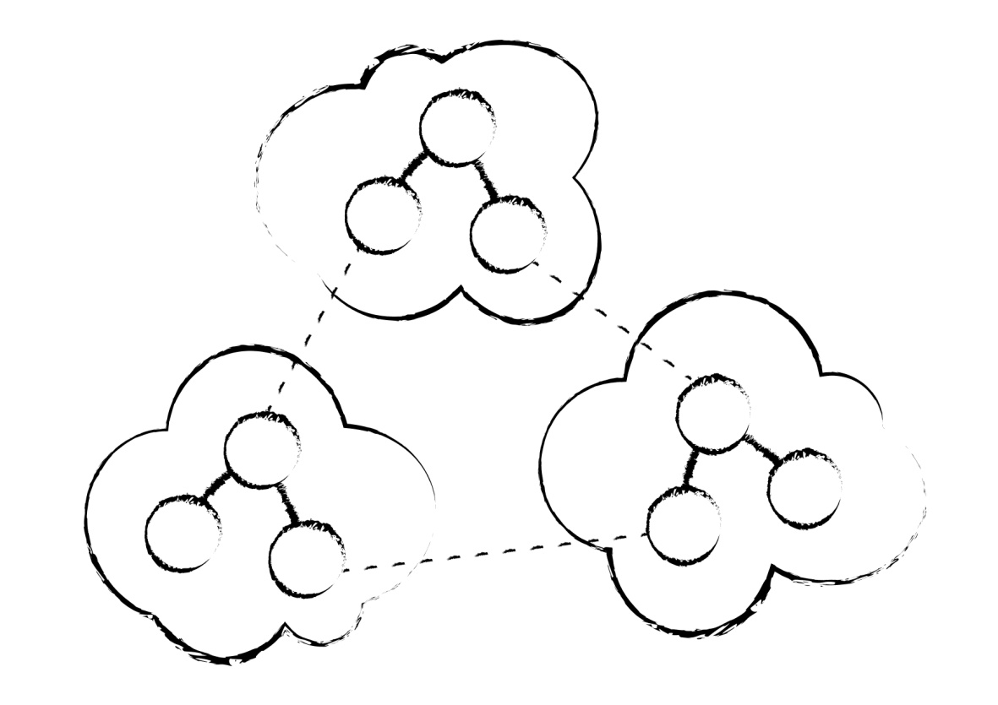
Introducing Semmtech
Focus on use of Open IT standards for sharing data
© Copyright Arcadis-Semmtech 2016
Notes:
Already >6 years R&D in Semantic Web-technology
Own SEMMweb suite of technology: publication platform, editorial tooling

Slide 6
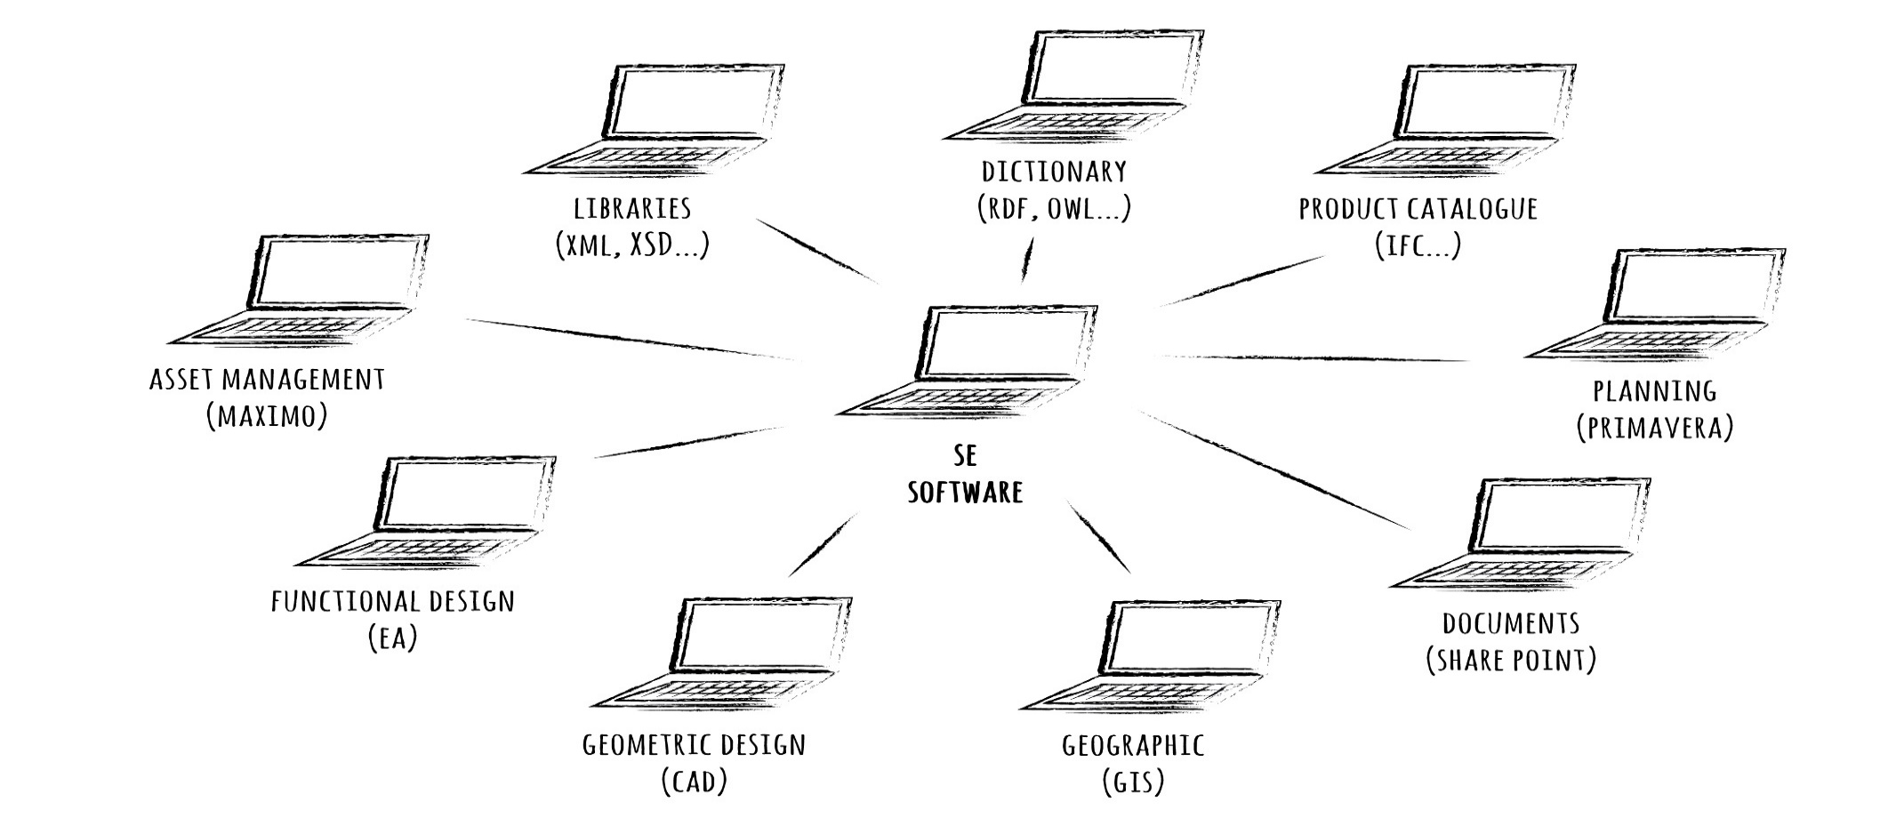
Introducing Semmtech
BIM vs.
MBSE vs.
AIM
Solving interoperability issues
© Copyright Arcadis-Semmtech 2016
Notes:
BIM - Building Information Model / Management
MBSE – Model Based Systems engineering
AIM – Asset Information Management
To us, BIM and MBSE and AIM are connected concepts!
They all relate to information on assets relevant for Principal (NRA’s) and its contractors during the life cycle of any asset

Slide 7
V-Con project
© Copyright Arcadis-Semmtech 2016

Slide 8
National road authorities
Responsible for road networks
Adequate information on assets is vital
For themselves
For contractors
Modernize information management: integrate and exchange using open standards
© Copyright Arcadis-Semmtech 2016

Slide 9
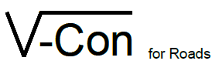
V-Con
Virtual Construction for Roads
European setting
Pre-Commercial Procurement process (PCP)
Issued by Dutch and Swedish national road authorities
Rijkswaterstaat (NL) and Trafikverket (SE)
© Copyright Arcadis-Semmtech 2016

Slide 10
V-Con objective
SE
CAD
Exchange and share asset information
Between different applications
Between different formats and ontologies
Solve interoperability issues with Linked Data
Linked
Data
Platform
AM
BIM
GIS
© Copyright Arcadis-Semmtech 2016

Slide 11
V-Con challenges
To exchange and integrate road asset information….
Challenge 1 – differences in formats / structures
Challenge 2 – differences in vocabulary
Challenge 3 – differences in entity identification
These are universal interoperability challenges!
© Copyright Arcadis-Semmtech 2016

Slide 12
Our approach
Interoperability through Semantic Web
Service-based architecture
Modular
Facilitates external applications
Logic captured in control models
Not hard-coded
Coherent and shareable
Optimal use of Semantic Web
Excels in interoperability – scalable, maintainable
© Copyright Arcadis-Semmtech 2016

Slide 13
Questions
Semmtech B.V.
www.semmtech.com
Sander Stolk: sanderstolk@semmtech.nl
Nic Roest: nicroest@semmtech.nl
© Copyright Arcadis-Semmtech 2016

